Slide 1
Embedded Systems
Project Review
Data Transfer Using Android Bluetooth using Arduino Uno Development Board

Slide 2
Team
Aditya Karnam - 12BCE1061
Pratik Kapasi - 12BCE1049
Anupritha S - 12BCE1132

Slide 3
Abstract
This project aims to bring Android and Arduino technology together to build an useful product.The project is also using a HC-05 bluetooth module to make the connection seamlessly wireless.
The Android Application will be transferring the data from the app to the Arduino board through the Bluetooth Module and the sent data will be printed on a 16 X 2 LCD interfaced with the Arduino Development Board.

Slide 4
Components
Arduino Uno Development Board
Bluetooth Module BC147 (HC-05)
16 x 2 LCD based on Hitachi's HD44780
Jumper Cables
Connector Wires
Power Supply (9V)(Optional)
2x Breadboard

Slide 5
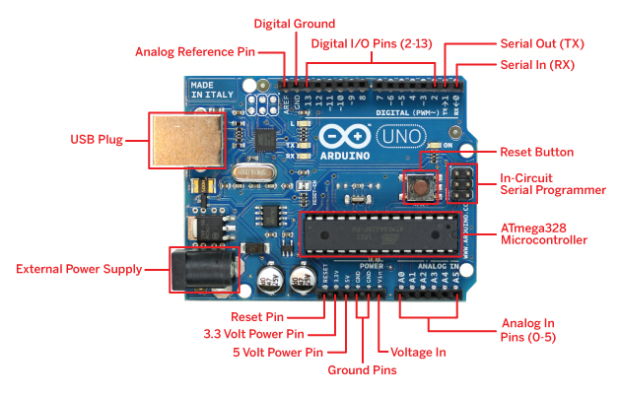
Arduino

Slide 6
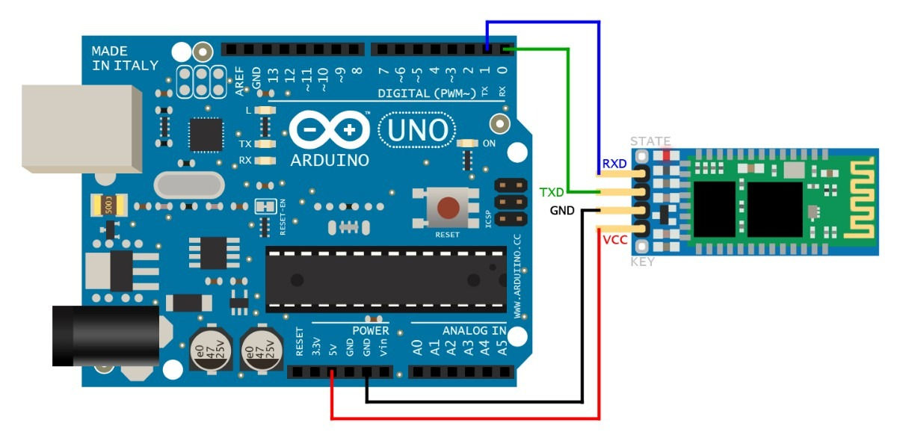
Arduino Bluetooth Interfacing

Slide 7
Android-Arduino
Android App will be developed using MIT App Inventor and interface and the programming for the app will be done for sending the sensor data to the arduino board.
From the board the data will be printed on the interfaced LCD.
The Android App will be using Bluetooth packages and Serial communication packages to achieve the objective.

Slide 8
LCD 16x2
LCD (Liquid Crystal Display) screen is an electronic display module and find a wide range of applications. A 16x2 LCD display is very basic module and is very commonly used in various devices and circuits. These modules are preferred over seven segments and other multi segment LEDs. The reasons being: LCDs are economical; easily programmable; have no limitation of displaying special & even custom characters (unlike in seven segments), animations and so on.
A 16x2 LCD means it can display 16 characters per line and there are 2 such lines. In this LCD each character is displayed in 5x7 pixel matrix. This LCD has two registers, namely, Command and Data.
The command register stores the command instructions given to the LCD. A command is an instruction given to LCD to do a predefined task like initializing it, clearing its screen, setting the cursor position, controlling display etc. The data register stores the data to be displayed on the LCD. The data is the ASCII value of the character to be displayed on the LCD. Click to learn more about internal structure of a LCD.

Slide 9
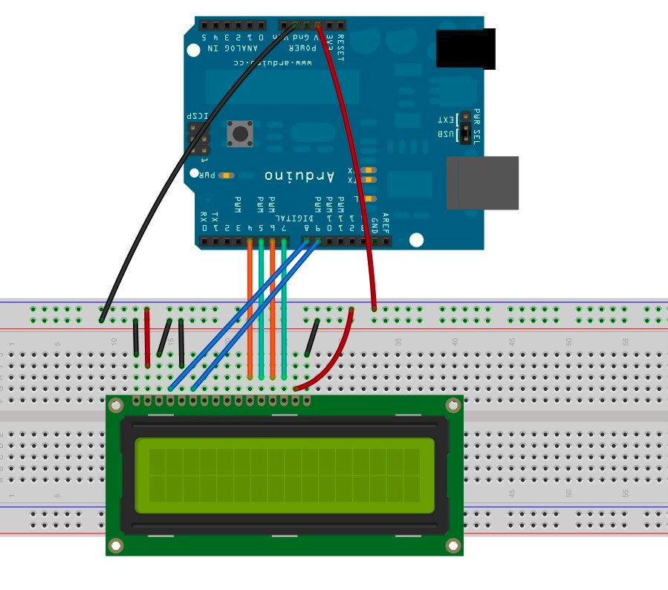
16x2 LCD Interfacing

Slide 10
LCD Working
The LCD doesn't do anything until you tell it to, it simply waits until it gets a valid enable rise and fall (which is when we put the enable pin high, wait for a while and then put the pin back low). At this point the display reads whether it is instructions or data to be processed, then whether it will receive or send information and last the data bits are sent or received.
In this article we will never receive information from the LCD so the R/W pin will always be low which means write.
The RS pin will be low except for when we print characters, everything else is considered instructions.
This makes it really simple to program the display.
When we know this we want to start with turning the display on and make it ready to receive information. This is done in the initialization sequence where we tell the display to be turned on, which "function set" to use, etc.
The power should already be on if you get the power from a spare power cable in the PC, otherwise this is the first thing to do.
Next is the "Function set" which is dependent on what display you have.
To make it more easy to understand I will explain exactly what we do when we use the function set.
DB2 is the Character Font bit and this should be low meaning 5x7 dot matrix.
DB3 is the Display Lines bit and should be high meaning 2 lines. What if you have 4 lines on the display? Don't worry, the first and third line are the same in the display memory so you should use high to.
DB4 is the Data Length bit and this decides if you have 4 or 8 DB, if you connect the display according to my schematics you should have this DB high.
Then set DB5 high to tell the display that this is indeed a "Function Set" instruction, then make sure that RS and R/W is low and do a enable rise and fall. For timings check the manual, i assume we only pause for microseconds when waiting for the display which should be much more than needed.

Slide 11
Challenges Faced :
Baud Rate :
The baud rate of the Bluetooth Module was at default 9600bps.Also the default baud rate of USB interface is also same.So we have changed the baud rate to 115200bps.
LCD Interfacing : Unconventional PIN diagram due to different LCD model the circuit diagram helps us with this.
Observations :
Bluetooth Operating range tested : 10-12 meters.
Bluetooth Operating range with obstacles(ex a door) : 8-10metres

Slide 12
Extension To Project
The project can be extended to develop simple and attractive games.
The main focus in game development is animation which can be achieved in LCD by simple loops and break conditions.
For example :
Movement of a dot can be shown by displaying a dot at a single position, clearing the display and incrementing the position and using a 'for' loop.
The speed of the dot can be controlled by varying the incrementing position, delay used to keep the keep the dot displayed on the screen and by keeping a track of the previous positions to display a trace.
Similarly , several animations can be obtained, custom characters can be created (ex PACMAN) and they can be used to create attractive games.
The LCDs of bigger dimensions may be used for this. They also support RGB mode of backlight.
Thus varying the backlight , custom characters and animation can be clubbed up in the development of good games.

Slide 13
Thank You

